Slide 1
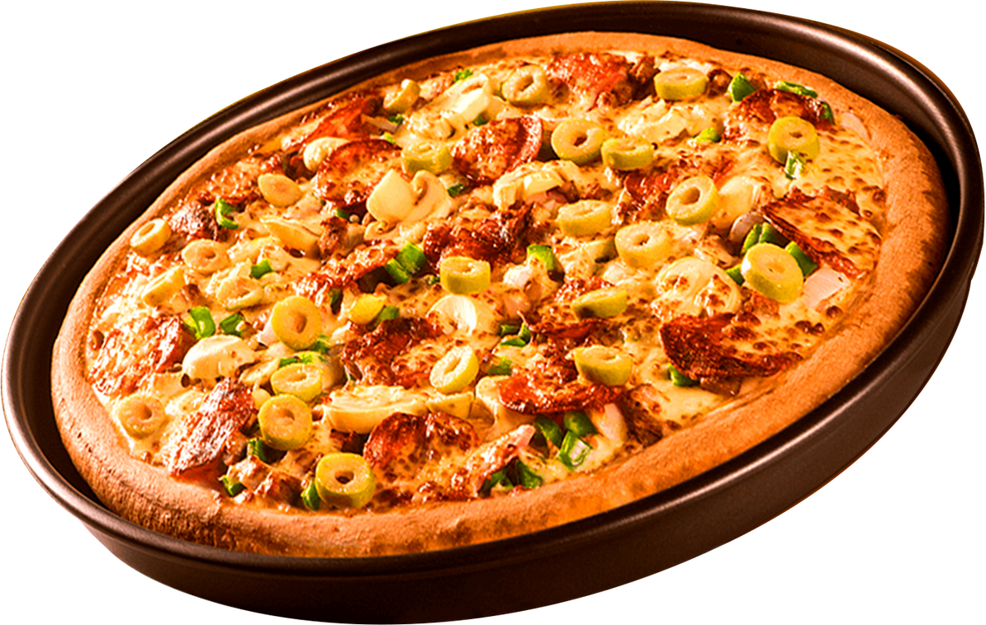
Home
About
Contact
PIZZA SALES PROJECT USING SQL

Slide 2
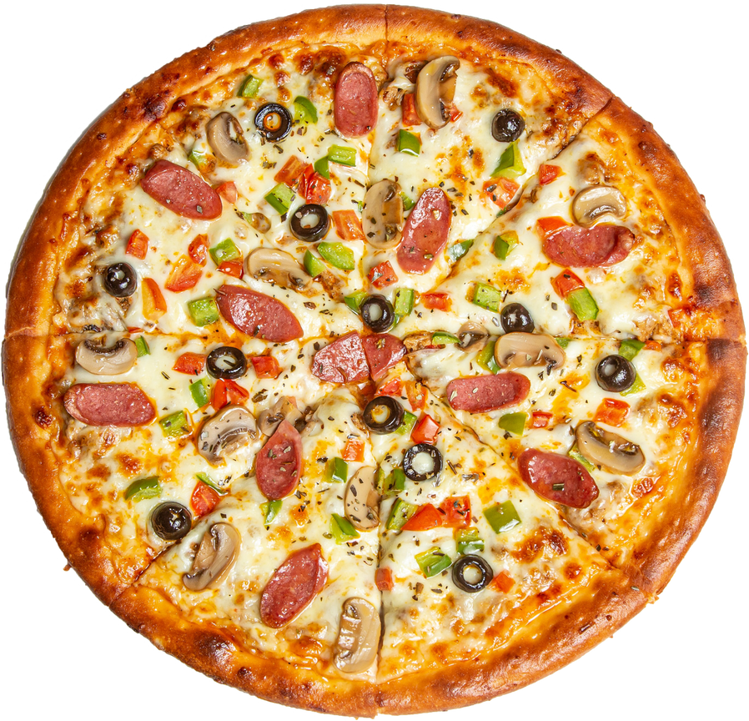
Home
About
Contact
HEELO
MY NAME IS RINKI GOSWAMI .
IN THIS PROJECT I HAVE UTILIZED SQL QUERIES TO SOLVE QUESTIONS THAT WERE RELATED TO
P IZZA SALES

Slide 3
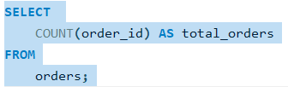
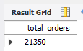
RetrIEVE THE TOTAL NUMBER OF ORDERS PLACED.
About
Contact

Slide 4

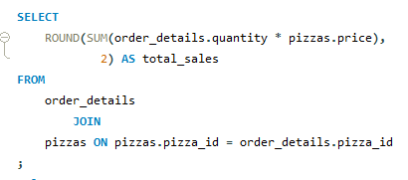
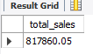

CALCULATE THE TOTAL REVENU GENERATED FROM PIZZA SALES.
Home
About
Contact

Slide 5
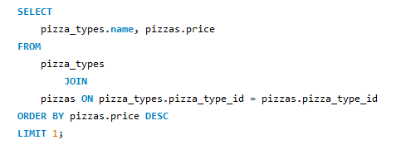
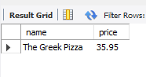
IDENTIFY THE HIGHEST-PRICED PIZZA
Home
About
Contact

Slide 6
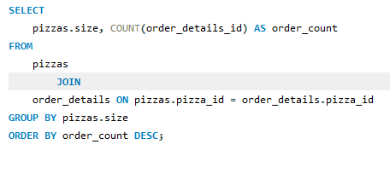
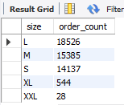
IDENTIFY THE MOST COMMON PIZZA SIZE ORDERED..
Home
About
Contact

Slide 7
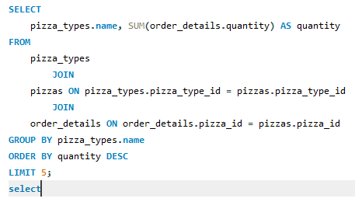
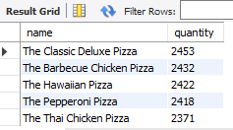
LIST THE TOP 5 MOST ORDERED PIZZA TYPES ALONG WITH THEIR QUANTITIES.
Home
About
Contact

Slide 8
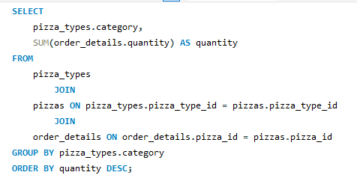
JOIN THE NECESSARY TABLES TO FIND THE TOTAL QUANTITY OF EACH PIZZA CATEGORY ORDERED.
Home
About
Contact

Slide 9
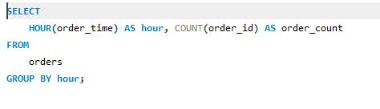
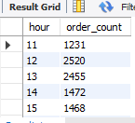
DETERMINE THE DISTRIBUTION OF ORDERS BY HOUR OF THE DAY.
Home
About
Contact

Slide 10
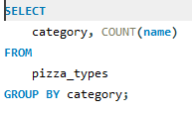
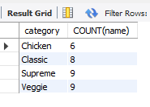
JOIN RELEVANT TABLES TO FIND THE CATEGORY-WISE DISTRIBUTION OF PIZZAS.
Home
About
Contact

Slide 11
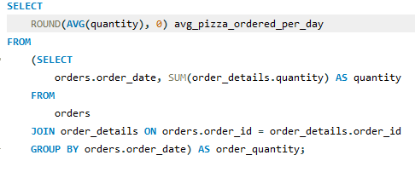
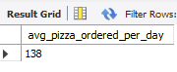
GROUP THE ORDERS BY DATE AND CALCULATE THE AVERAGE NUMBER OF PIZZAS ORDERED PER DAY.
Home
About
Contact

Slide 12
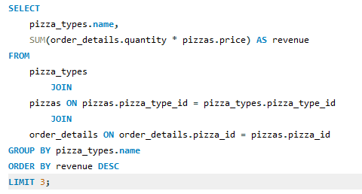
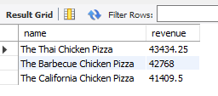
DETERMINE THE TOP 3 MOST ORDERED PIZZA TYPES BASED ON REVENUE.
Home
About
Contact

Slide 13
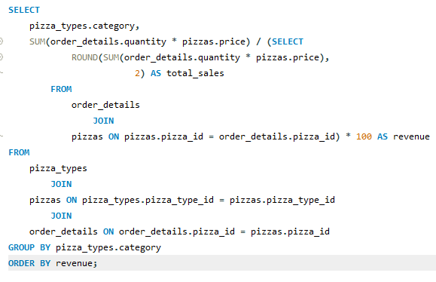
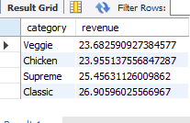
ALCULATE THE PERCENTAGE CONTRIBUTION OF EACH PIZZA TYPE TO TOTAL REVENUE.
Home
About
Contact

Slide 14
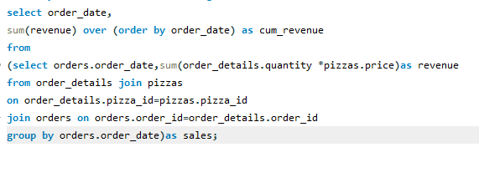
ANALYZE THE CUMULATIVE REVENUE GENERATED OVER TIME.
Home
About
Contact

Slide 15
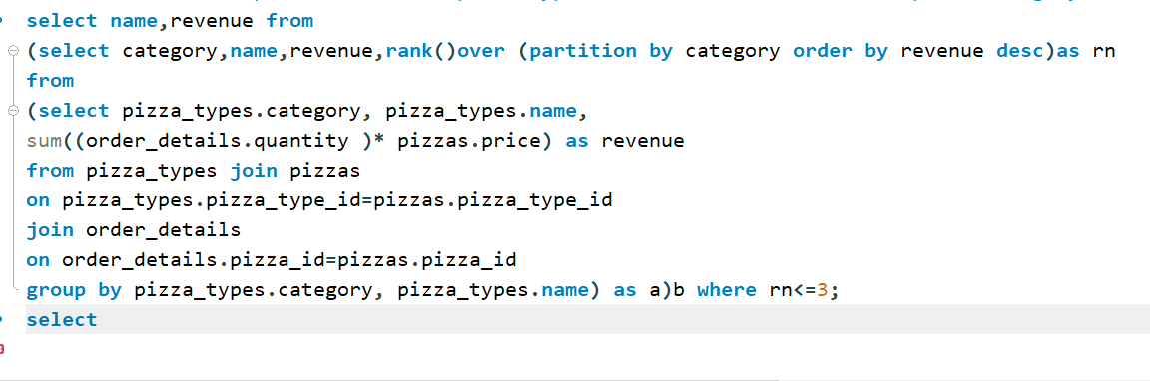
DETERMINE THE TOP 3 MOST ORDERED PIZZA TYPES BASED ON REVENUE FOR EACH PIZZA CATEGORY.
Home
About
Contact

Slide 16
CONCLUSION
Home
About
Contact
This project was developed entirely using SQL, focusing on designing and managing a relational database system. Through this project, I created multiple tables, inserted meaningful data, and wrote queries to retrieve, update, and manipulate the data efficiently. The project helped me understand the core concepts of SQL such as table creation, data types, constraints, joins, subqueries, and aggregate functions. Overall, it was a valuable hands-on experience in working with databases using pure SQL.

Slide 17
About
Contact
THANK YOU

